Slide 1
foldr
CS 5010 Program Design Paradigms “Bootcamp”
Lesson 6.4
© Mitchell Wand, 2012-2017
This work is licensed under a Creative Commons Attribution-NonCommercial 4.0 International License.
TexPoint fonts used in EMF.
Read the TexPoint manual before you delete this box.: AAA

Slide 2
Introduction
In this lesson, we will explore another common pattern in functions defined by the list template.
We will generalize this to a function called foldr.
We will visualize how foldr works, and show an important application area.

Slide 3
Learning Objectives
At the end of this lesson you should be able to:
describe, recognize, and use the foldr pattern.

Slide 4
What else could be different?
;NumberList -> NumberList
(define (add-1-to-each lon)
(cond
[(empty? lon) empty]
[(else (cons
(add1
(first lon))
(add1-to-each
(rest lon))))]))
;EmployeeList -> ListOfString
(define (extract-names lop)
(cond
[(empty? lop) empty]
[else (cons
(Employee-name
(first lop))
(extract-names
(rest lop)))]))
Here is the example we used to introduce map. In this example, both of the brown functions are cons, but in some other function there could be something else in that position.

Slide 5
Another example
;; NumberList -> Number
(define (sum lon)
(cond
[(empty? lon) 0]
[else (+
(first lon)
(sum
(rest lon)))]))
;; NumberList -> Number
(define (product lon)
(cond
[(empty? lon) 1]
[else (*
(first lon)
(product
(rest lon)))]))
Both these functions take a list of numbers and return a number. sum returns the sum of the elements of the given list. product returns the product of the elements of the given list.
These functions are just alike, except for the differences marked in red and green.

Slide 6
Let's generalize these
sum and product can be generalized to a function we call foldr, with two new arguments: one called fcn, for the function in the green position, and one called val, for the value in the red position. The strategy for foldr is using the template for XList on its list argument.
Our original sum and product functions can be recreated by supplying + and 0, or * and 1, as the two arguments. The strategy for these new versions of sum and product is "Use HOF foldr on ...".
The name foldr is a standard name for this function, so that is the name we will use. foldr is already defined in ISL, so you don't need to write out the definition.
Let's look at the code:

Slide 7
Create two new arguments for the two differences.
We call this "foldr" (we'll explain the name later)
(define (foldr fcn val lon)
(cond
[(empty? lon) val]
[else (fcn
(first lon)
(foldr fcn val (rest lon)))]))
;; strategy: Use HOF foldr on lon
(define (sum lon) (foldr + 0 lon))
(define (product lon) (foldr * 1 lon))
This is predefined in ISL, so you don't need to write out this definition

Slide 8
What is the purpose statement?
;; foldr : (X Y -> Y) Y XList -> Y
;; RETURNS: the result of applying f on the
;; elements of the given list
;; from right to left, starting with base.
;; (foldr f base (list x_1 ... x_n))
;; = (f x_1 ... (f x_n base))

Slide 9
What is the contract for foldr?
Based on our two examples we might guess the following contract for foldr: Here is one guess for the contract for foldr, based on our two examples:
foldr :
(Number Number -> Number) Number NumberList
-> Number
This works, because + and * both have contract (Number Number -> Number), and 0 and 1 are both numbers.

Slide 10
What is the contract for foldr?
But there is nothing in the definition of foldr that mentions numbers, so foldr could work at contract
(X X -> X) X XList -> X
that is, you could use foldr at
(Boolean Boolean -> Boolean)
Boolean
BooleanList
-> Boolean
or
(Employee Employee -> Employee)
Employee
EmployeeList
-> Employee
The 3 arguments to foldr
The 3 arguments to foldr

Slide 11
Let's watch foldr compute on this list
fcn
y4
x4
x4
fcn
y3
x3
x3
fcn
y2
x2
fcn
y1
x2
x1
val
x1
empty
Step through the animation to watch the computation of
(foldr fcn val (list x4 x3 x2 x1))

Slide 12
What can we learn from this?
The base value val is a possible 2nd argument to fcn.
The result of fcn becomes a 2nd argument to fcn.
So this will work as long as
val,
the 2nd argument to fcn,
and the result of fcn
are all of the same type.
So fcn must satisfy the contract (X Y -> Y) for some X and Y.

Slide 13
What else can we learn?
The elements of the list become the first argument to fcn.
So if fcn satisfies the contract (X Y -> Y), then the list must be of type XList.
So the contract for foldr is:
foldr : (X Y -> Y) Y XList -> Y

Slide 14
The contract for foldr (again!)
The contract for foldr is
So foldr takes 3 arguments:
a combiner function that satisfies the contract
(X Y -> Y)
a base value of type Y
and a list of X's.
And it returns a value of type Y.
foldr : (X Y -> Y) Y XList -> Y

Slide 15
Another picture of foldr
Here's another visualization of foldr that you may find helpful.
(
x1
x2
x3
x4
x5
)
f
f
f
f
f
val
(foldr f val (list x1 ... x5))

Slide 16
What kind of data is on each arrow?
xi
Y
X
Y
Y
f

Slide 17
We can think of foldr as starting with the base value val, and putting it through a pipeline of f's, where each f also takes one of the x's as an input. The x's are taken right-to-left, which is why it is called foldr .
(
x1
x2
x3
x4
x5
)
f
f
f
f
f
val
(foldr f a (list x1 ... x5))

Slide 18
Another example:
;; strategy: combine simpler functions
(define (add1-if-true b n)
(if b (+ n 1) n))
;; strategy: Use HOF foldr on lob
(define (number-of-trues lob)
(foldr add1-if-true 0 lob))
Or even better:
;; strategy: Use HOF foldr on lob
(define (number-of-trues lob)
(local ((define (add1-if-true b n)
(if b (+ n 1) n)))
(foldr add1-if-true 0 lob)))
What is the contract for add1-if-true ? At what contract is foldr being used in this example? What is returned by count-trues ? Try to answer these questions before proceeding to the next slide.

Slide 19
What are the contracts?
add1-if-true : Boolean Number -> Number
In general:
foldr : (X Y -> Y) Y XList -> Y
In this case, X = Boolean and Y = Number, so we are using
foldr at the contract
(Boolean Number -> Number)
Number BooleanList -> Number
and therefore
count-trues : BooleanList -> Number
Notes:
... and here's the answer. foldr is being used with X = Boolean and Y = Number.

Slide 20
Local functions need contracts and purpose statements too
(define (count-trues lob)
(local (; add1-if-true : Boolean Number -> Number
; RETURNS: the number plus 1 if the boolean is
; true, otherwise returns the number unchanged.
(define (add1-if-true b n) (if b (+ n 1) n)))
(foldr add1-if-true 0 lob)))
They count as help functions, so they don't need separate tests.
Local functions need their deliverables, too. They count as help functions, so they don't need separate tests. If they are complicated enough to need examples or tests, then you should make them independent functions with a full set of deliverables.

Slide 21
The whole thing (less examples and tests)
;; count-trues : BooleanList -> Number
;; RETURNS: the number of trues in the given list of booleans.
;; STRATEGY: Use HOF foldr on lob
(define (count-trues lob)
(local (; add1-if-true : Boolean Number -> Number
; RETURNS: the number plus 1 if the boolean is
; true, otherwise returns the number unchanged.
(define (add1-if-true b n)
(if b (+ n 1) n)))
(foldr add1-if-true 0 lob)))

Slide 22
HOFs can help you write code for trees, too
;; grandchildren : Person -> PersonList
;; STRATEGY: Use template for Person on p
(define (grandchildren p)
(all-children (person-children p)))
;; all-children : PersonList -> PersonList
;; STRATEGY: Use HOF map on ps
(define (all-children ps)
(foldr append empty
(map person-children ps)))
Remember grandchildren, from Lesson 5.2. Here’s a version that uses foldr in all-children.
A PersonList is a list, so we can use our list abstractions in the definition of all-children.
Compare this version of all-children with the one in Lesson 5.2. Do you see the connection?

Slide 23
Here is all-descendants, rewritten with foldr.
;; Person -> PersonList
;; STRATEGY: Use template for Person on p
(define (person-descendants p)
(append
(person-children p)
(all-descendants (person-children p))))
;; PersonList -> PersonList
;; STRATEGY: Use HOF map followed by foldr
(define (all-descendants ps)
(foldr append empty
(map person-descendants ps)))
The functions are still mutually recursive.

Slide 24
mapreduce
;; mapreduce : (Y Y -> Y) Y (X -> Y) XList -> Y
;; GIVEN: f v g (list x1 ... xn))
;; RETURNS:
;; (f (g x1) (f (g x2) (f (g x3) ... v)))
(define (mapreduce f v g lst)
(foldr f v (map g lst)))
Many problems can be stated in this form, with f associative, and v the identity of f.

Slide 25
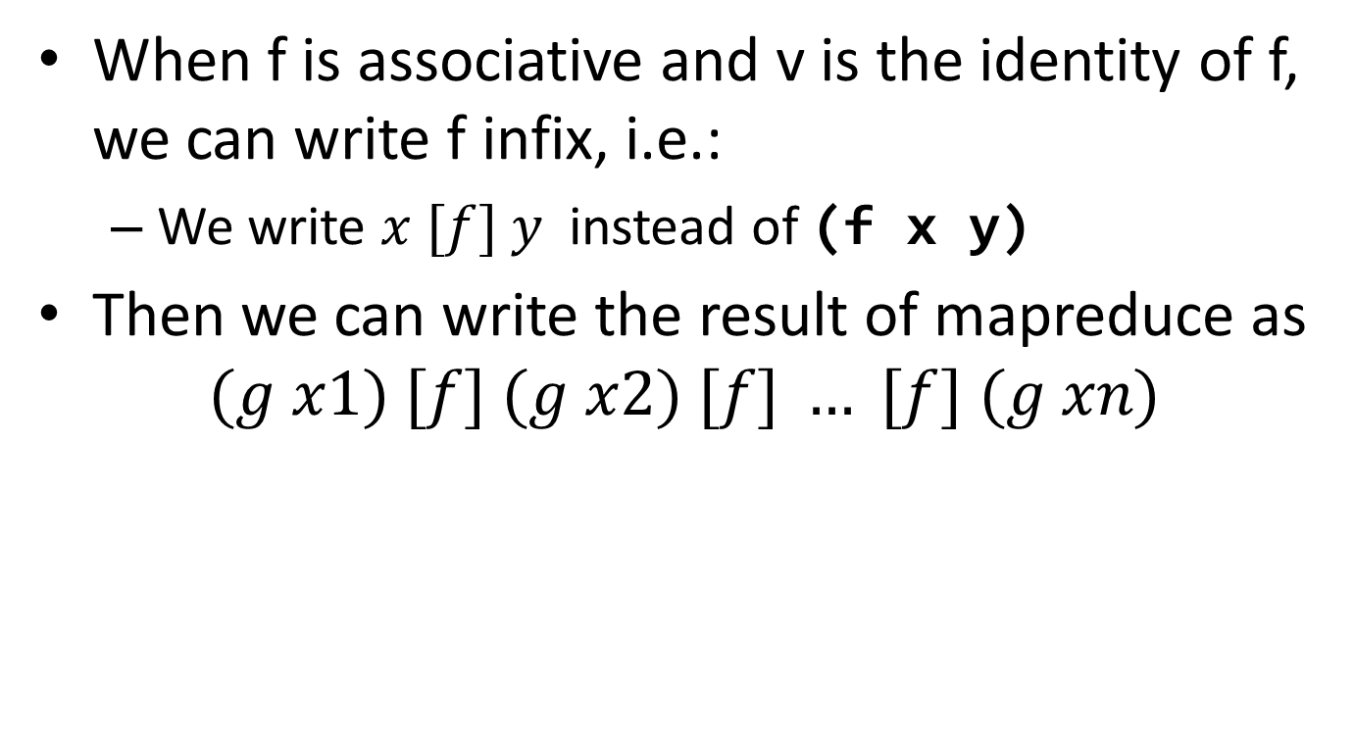
Mapreduce (cont’d)
When f is associative and v is the identity of f, we can write f infix, i.e.:
We write $x [f] y$instead of (f x y)
Then we can write the result of mapreduce as
$$(g x1) [f] (g x2) [f] … [f] (g xn)$$

Slide 26
Tiny Example
;; BoolList -> NonNegInt
;; RETURNS: the number of trues in the given list of
;; Booleans.
(define (number-of-trues lob)
(let ((mapper (lambda (b) (if b 1 0))))
(mapreduce + 0 mapper lob)))
+ is associative, and 0 is its identity

Slide 27
Many database tasks can be expressed in this form
SQL operations:
Count
Filter
ALL
EXISTS

Slide 28
Why this wins
When f is associative, and v is its identity, can turn the calls to f into a tree and do them in parallel on a server farm!
For a data set of size n, this reduces the processing time from n to log(n).
Here is a picture:

Slide 29
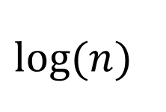

From linear time to logarithmic
f
h
f
f
$$n$$
h
h
f
f
$$log⁡(n)$$
h
f
h
f
f
f
h
f
f
f
f
f
h
f
h
v
h
h
h
h
h
h
h
h

Slide 30
You could do some of this in parallel
Divide the subtrees across several different processors or clusters…

Slide 31
Where does the data come from?
The data might not be a list.
It might be data extracted from a large database.
So your application would have 2 parts
some SQL to extract a table full of data (like "map")
the function you want to reduce the data with.
The SQL insulates your application from the physical layout of the DB; the SQL query optimizer can probably get your data out of the DB fast.
mapreduce systems (like Hadoop or Spark) allow you to configure the 'reduce' phase to make use of the available hardware.

Slide 32
Summary
You should now be able to:
describe, recognize, and use the foldr pattern.
state the contracts for ormap, andmap, and filter and foldr, and use them appropriately.
combine these functions using higher-order function combination.

Slide 33
Next Steps
If you have questions about this lesson, ask them on the Discussion Board
Do Guided Practice 6.4
Go on to the next lesson

